Slide 1

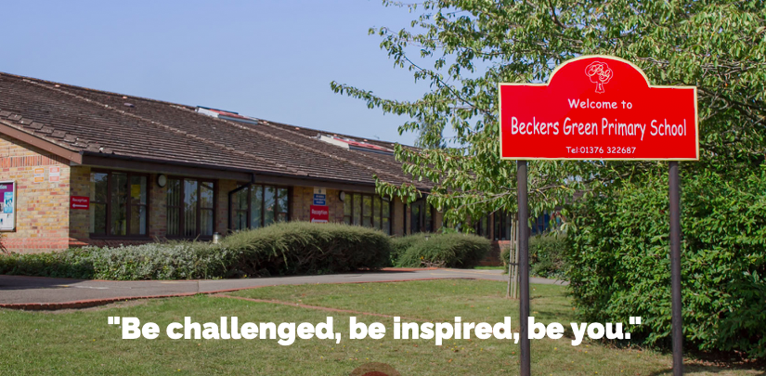
The ZONES of Regulation®
Beckers Green Primary School
Notes:
Short presentation explaining the concept of zones of regulation that your child or their teacher might have spoken to you about. It will look at what zones are and why we use them along with how we can work together to support your child.

Slide 2

content
Overview of the Zones
How to incorporate the Zones at home
Self-regulation tools
    Calming techniques
    Thinking strategies
    Sensory supports

Slide 3

Life is 10% what happens to us and 90% how we react to it. -Charles Swindoll
Notes:
We need self-regulation skills because we can’t often control what happens to us but we can control how we react to it

Slide 4

What are The ZONES of Regulation®?
Concept designed by Leah Kuypers, occupational therapist
Teaches students:
  Vocabulary of emotional terms
  How to recognise their own emotions
  How to detect emotions of others
  How others interpret their behaviour
  Calming and alerting strategies
  Problem solving skills
Notes:
categorizes all the different ways we feel and states of alertness into 4 colors

Slide 5
Why teach the Zones?!
  It gives students, teachers, and parents a common language to discuss emotions.
  The Zones of Regulation are simple for children to understand.
    Children know the different colours, recognise their feelings and use strategies to move to Green Zone (calm down or feel okay).
  Teaching healthy coping and regulation strategies which allows children to help themselves when they become stressed, anxious, or sad.
  Typically, children who can self-regulate will turn into teens who can self-regulate.
  Understanding the emotions of others helps with empathy and friendship skills.

Slide 6
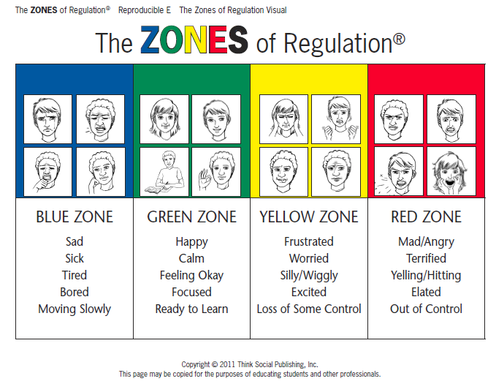
Notes:
State of alertness – blue – low, green is ideal, yellow is high, red is extremely high.
All students at BG have been introduced to the zones. Many already know their strategies to get to green, depending on the class.

Slide 7
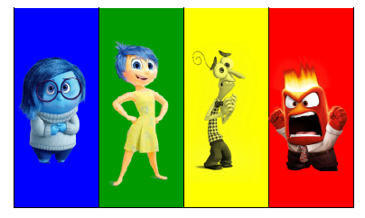
Other ZONES Visuals
Notes:
Inside out relates nicely to the Zones!
Each zone can be appropriate in different circumstances, we aren’t always be expected to be in green. For example, if you came home and your house was being robbed it would be expected for you to be in red, but if you were in the green people might be concerned for you.. ;)

Slide 8
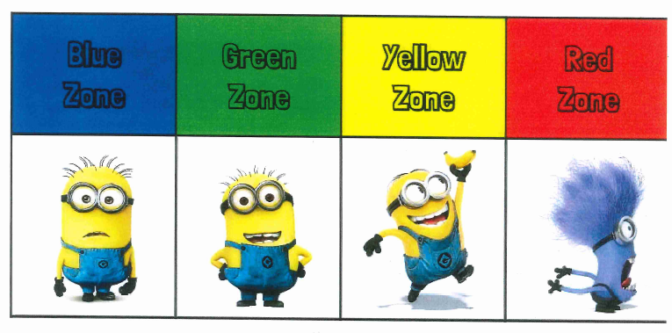
Other ZONES Visuals

Slide 9
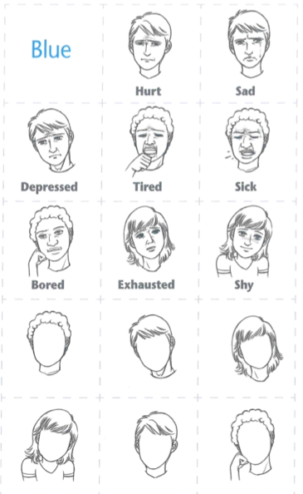
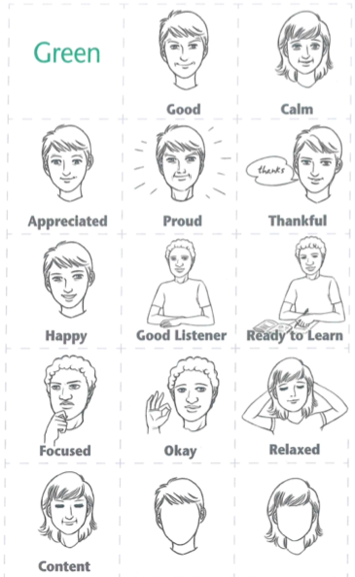
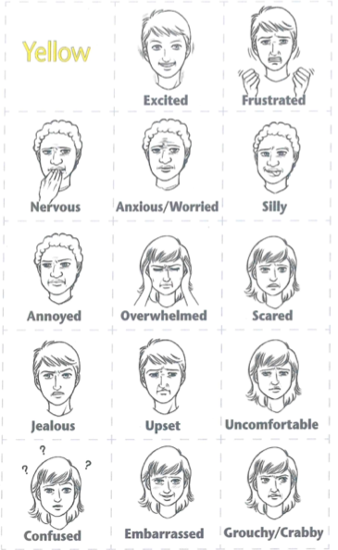
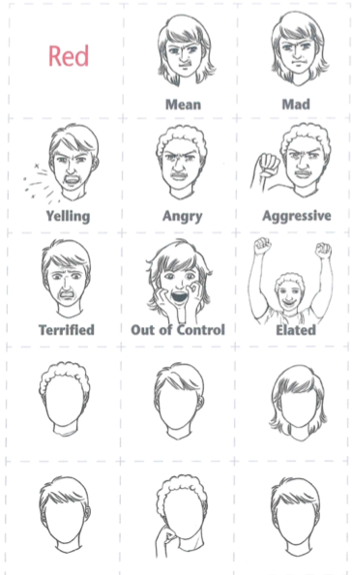
Resources to support recognising which zone
Notes:
We use visuals such as these in school so that children recongnise what the emotion might look like

Slide 10
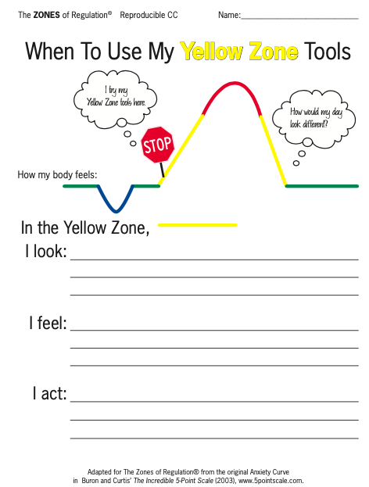
The Anxiety curve
Notes:
We talk about the anxiety curve and help children to recognise and track the signs in the body that happen when they are moving between the zones. If they can recognise the signs of yellow for example, then we can help them to manage these feelings at this point before getting to the red zone. So, we talk about what feeling in each zone looks like so that we can use the language such as ‘I can see that you are in your yellow zone…’ when it happens.
Important to remember that self regulation does not always mean being securely in the green zone. A little stress is a good thing. It motivates kids to study – The nervous energy during the test helps the mind actively recall what you know and work at a good pace so you can finish on time. The goal is to understand your child and then help them regulate

Slide 11
Recognising emotions is the first step to regulating them
How does your body tell you you’re getting..
Tired?
Stressed?
Frustrated?
Calm?
What clues can we look for to know what zone someone is in?
Notes:
The first thing we want students to know is how to identify feelings in themselves and others. We start by looking for face and body clues and noticing where we feel emotions in our bodies.

Slide 12
How can I support the Zones of Regulation?
• Identify your own feelings using Zones language in front of your child (e.g. “I’m frustrated, I am in the yellow zone”)
• Talk about what tool you will use to be in the appropriate zone (e.g. “I’m going to go for a walk, I need to get to the green zone”)
• Label what zones your child is in throughout the day (e.g. “you look sleepy, are you in the blue zone?”)
• Teach your child what Zones tools they can use (e.g. “it’s time for bed, let’s read a book together in the rocking chair to get to the blue zone”)
• Share how their behavior is affecting your zone (e.g. “It puts me in the blue zone when you ignore me”)
• Post and reference the Zones visuals and tools in your home.

Slide 13
Validate feelings - There is no such thing as a bad ZONE.
Everyone experiences all of the Zones—the Red and Yellow Zones are not “naughty” zones. (e.g., “It’s totally okay to feel angry, but it’s not okay to hit”)
UNEXPECTED RED ZONE TIP
Use worthwhile verbal communication – this is not a teachable moment.
Validate their feelings.
Give them time and space.
Process and teach skills later when calm.
Notes:
When kids are in the red zone, it’s important to give them space to calm down before teaching any strategies or problem-solving.

Slide 14
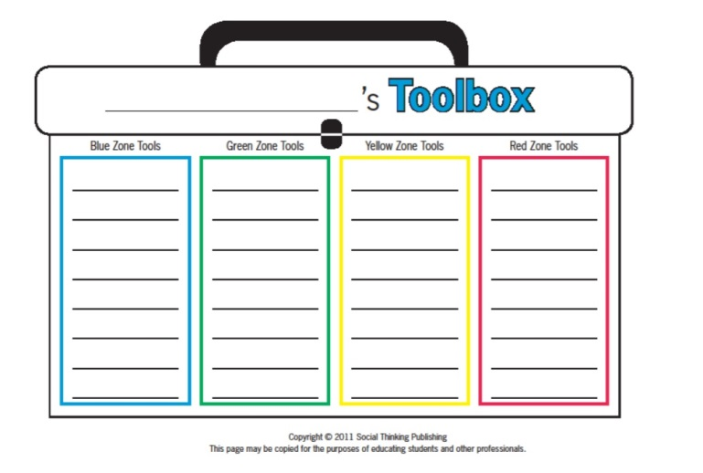
Create toolboxes

Slide 15
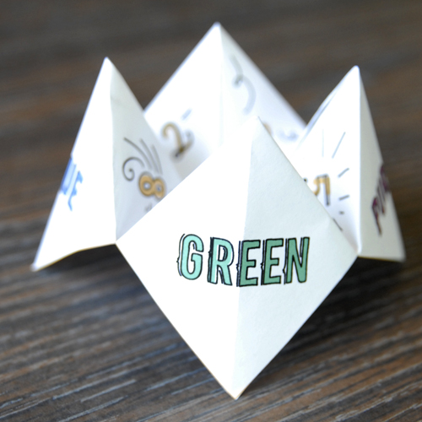
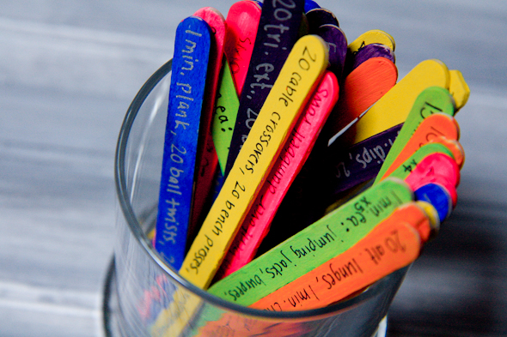
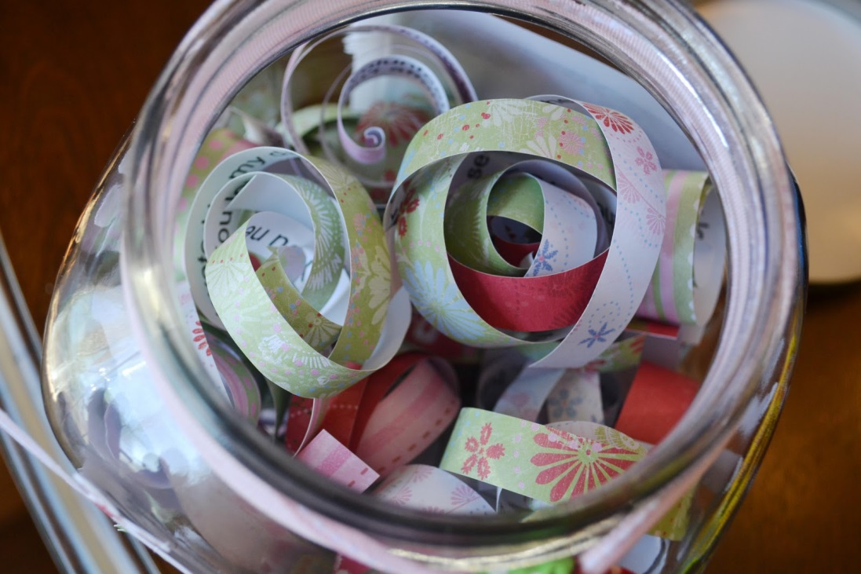
Other toolbox ideas
Notes:
Find endless ideas on Pinterest!

Slide 16
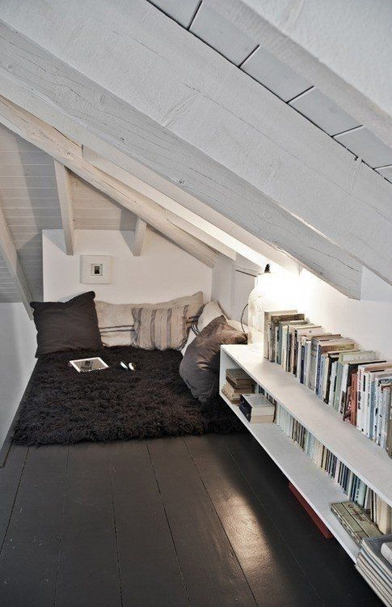
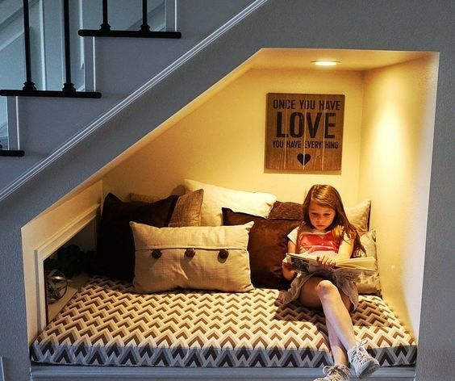
Chill Zone
Quiet Space
Zen corner reading nook
Safe place relaxation station
Notes:
You could have a box full of arts and crafts, sensory tools, etc.

Slide 17
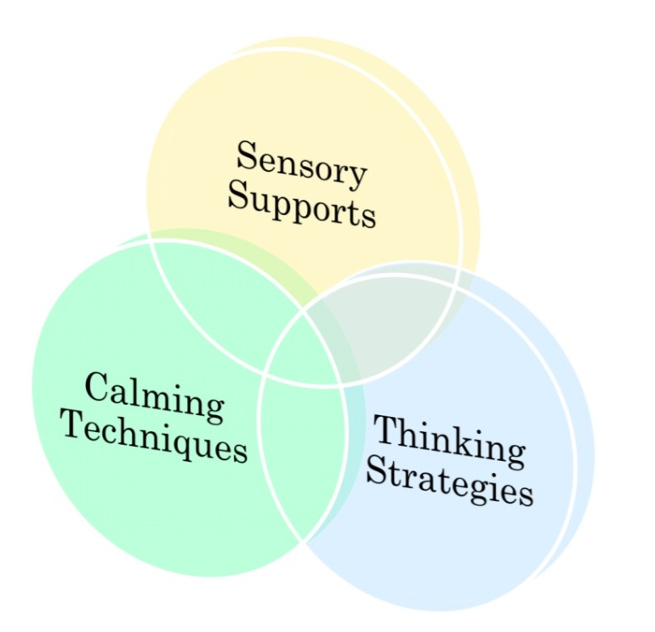
Tools for self-regulation
Notes:
They all overlap but I’ve tried to categorize them

Slide 18
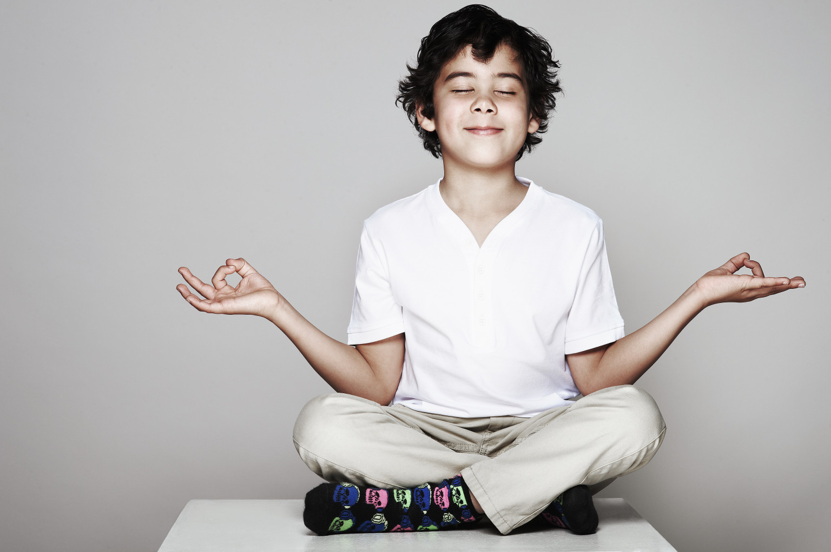
Calming techniques

Slide 19
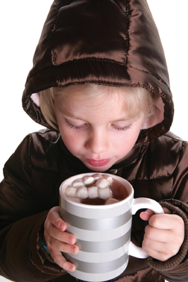
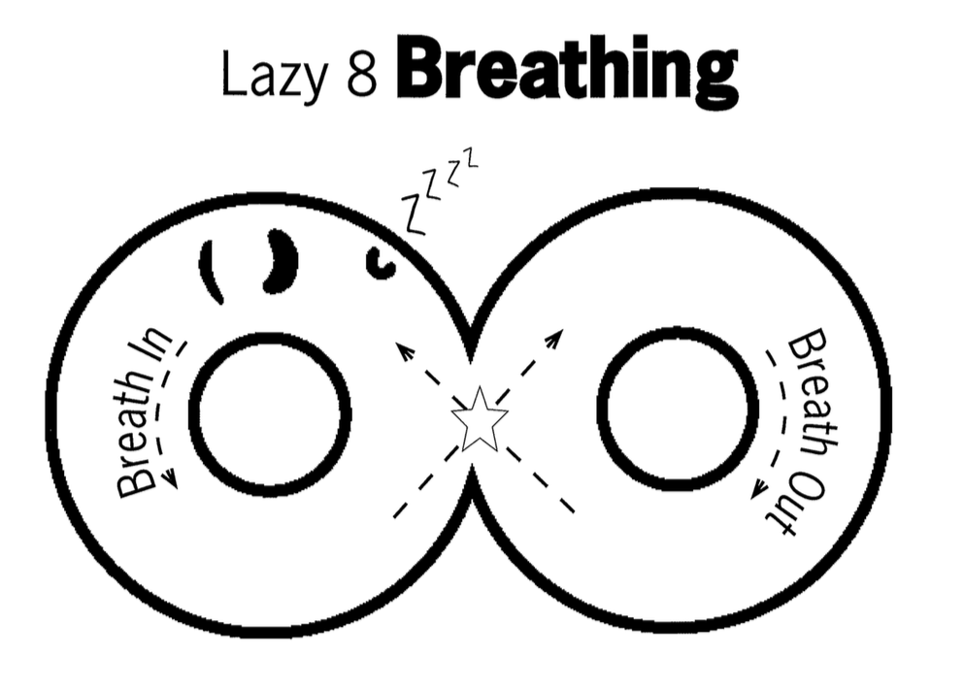
DEEP BREATHING
Notes:
May want to make the sign of an 8 on its side and follow with the hand. In through your nose, out through your mouth. To help kids remember, I have them imagine they’re smelling hot yummy hot cocoa and then blowing on it to cool it down.

Slide 20

Counting
Forward and backward
Count objects
Count colors
Count breaths
Count pulse

Slide 21

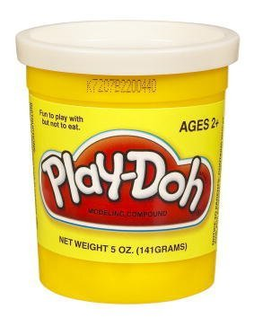

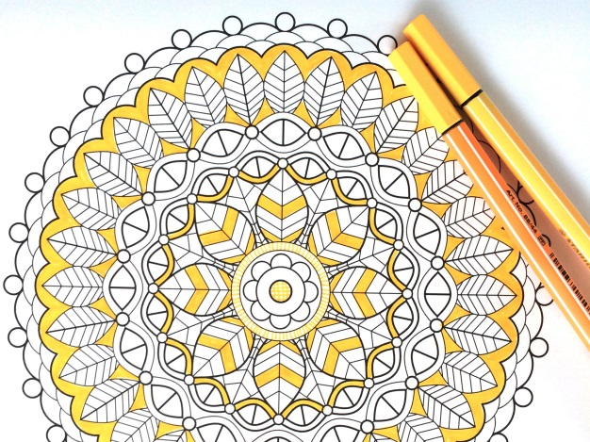
Calming Activities
Puzzles
Listen to music
Draw/paint/colour
Play-Doh/clay
Read
Notes:
Coloring books with non-dominant hand

Slide 22


Thinking strategies

Slide 23
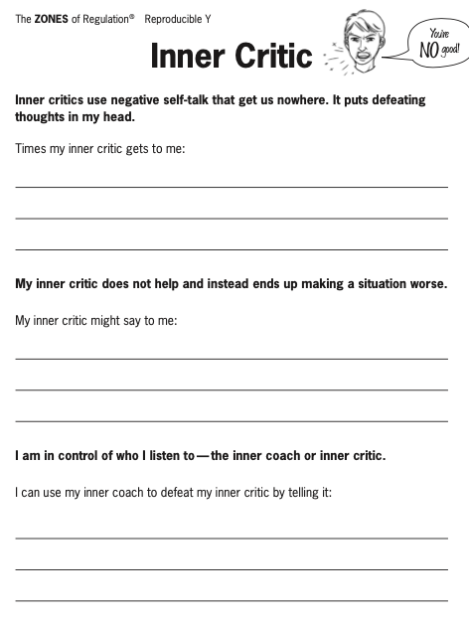

Inner coach vs inner critic
Notes:
. talking about the importance of building skills by letting yourself try things out and make mistakes. Your child wants to draw something related to a favorite sports team but didn’t have the right colors to represent the team. We talked about not expecting things to be perfect, but instead finding a way to get started and work with whatever you have.
We can help kids overcome inner obstacles that come with perfectionism and self-doubt. One effective approach is to use the concept of Inner Critic and Inner Coach. The Inner Critic is that voice of negativity telling you to give up because you’re not good or clever or talented enough. Inner critics offer negative self talk that doesn’t help – putting defeating thoughts in our heads and making situations worse. We identify times when the inner critic gets to us and what they might say – this teaches the children to recognise this.
The antidote to this is the Inner Coach, a voice that provides positive self-talk about the need to get started, not worry about the outcome, and believe in yourself. The Inner Coach tells you to give it a try and see what happens next. We teach the children that they are in control of who they listen to- the critic or the coach.

Slide 24
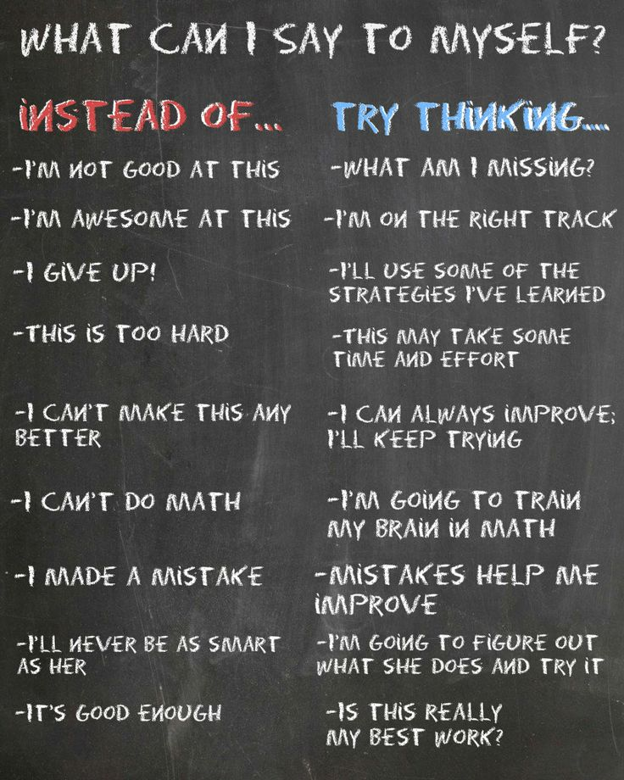

Positive Self-talk
Notes:
AKA our “inner coach”

Slide 25
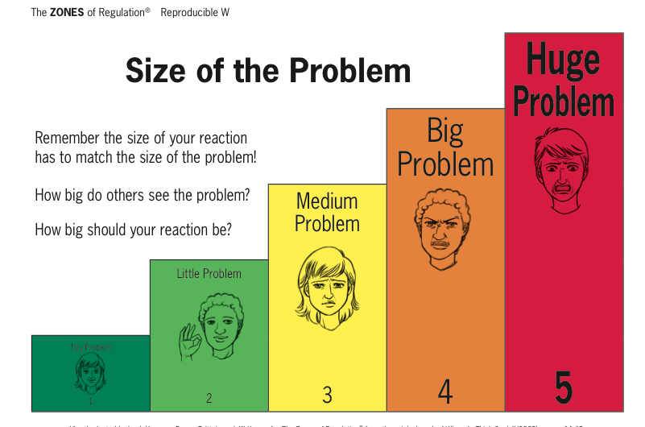
*Talk about which reaction is “expected” in the situation or how a reaction may have been “unexpected.”
*Reinforce having an expected reaction
Notes:
Make sure you frequently reinforce your child for have expected reactions rather than only pointing out the unexpected.

Slide 26
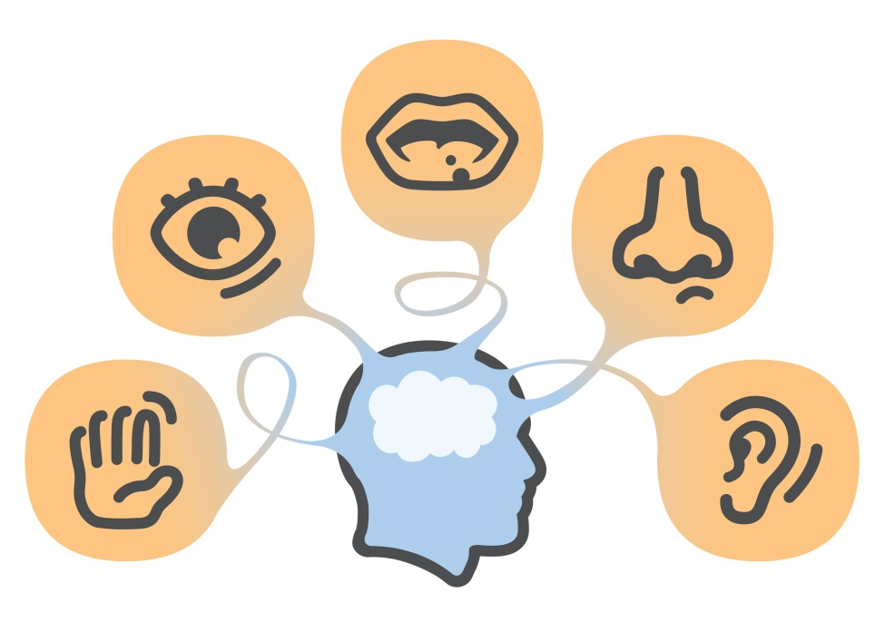
Sensory support

Slide 27

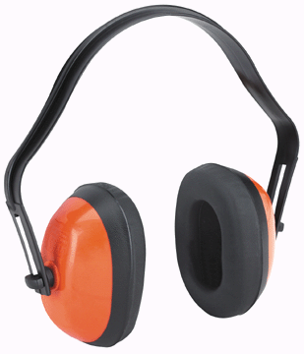
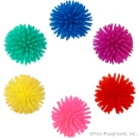

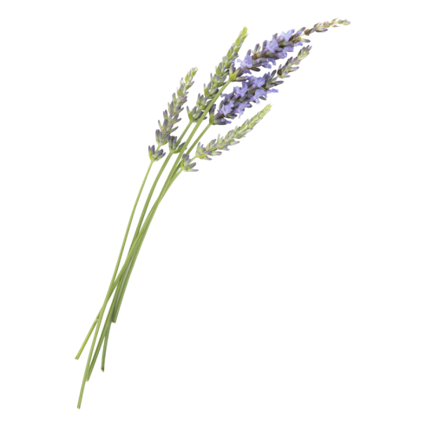
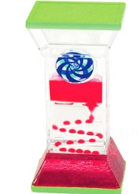
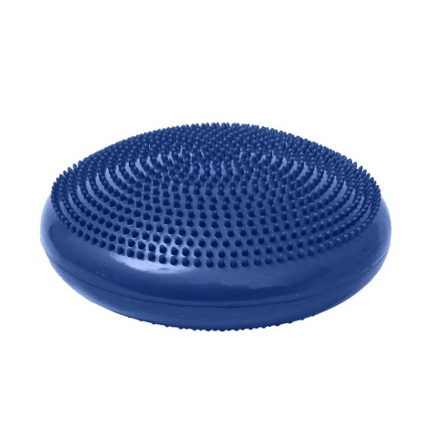
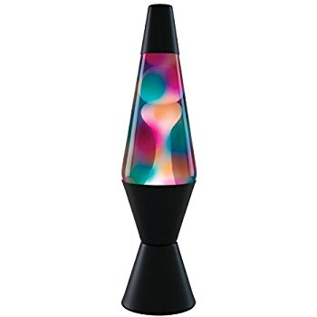
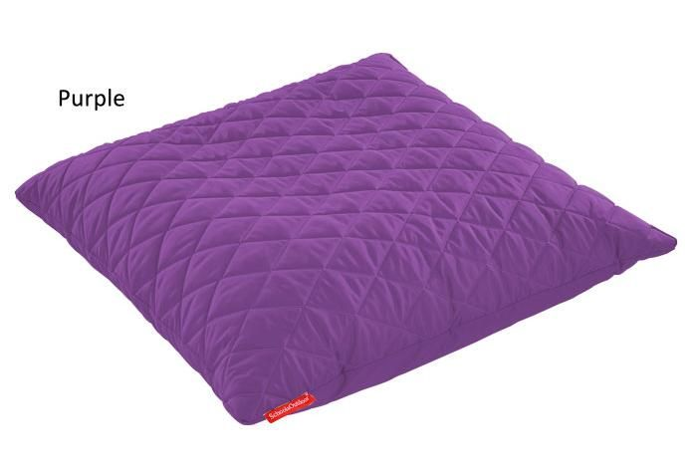
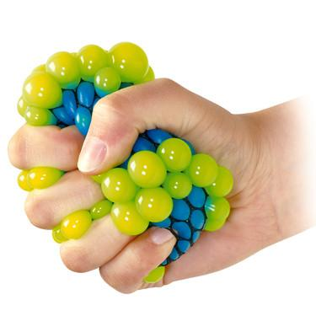
Sensory tools
Notes:
Create your own sensory shakers
Create a sensory bin
Have a IMPORTANT: Self-regulation tools should be available on an as-needed basis or at a scheduled break time. These tools should not be withheld as a consequence or used as a reward.

Slide 28
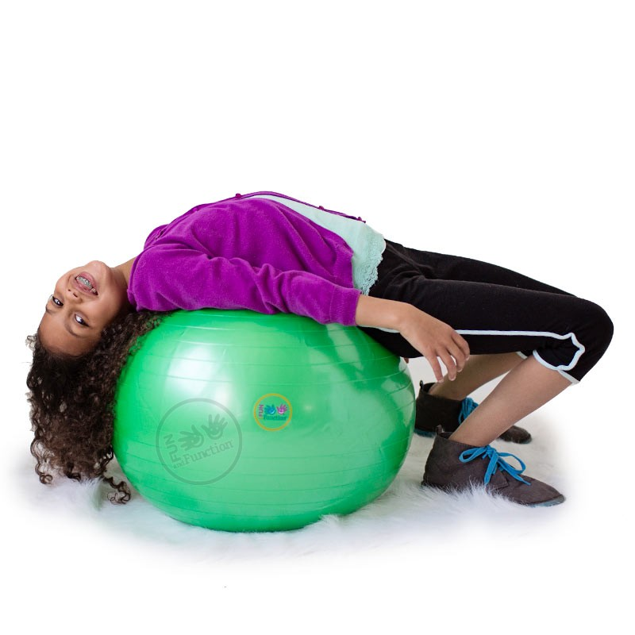
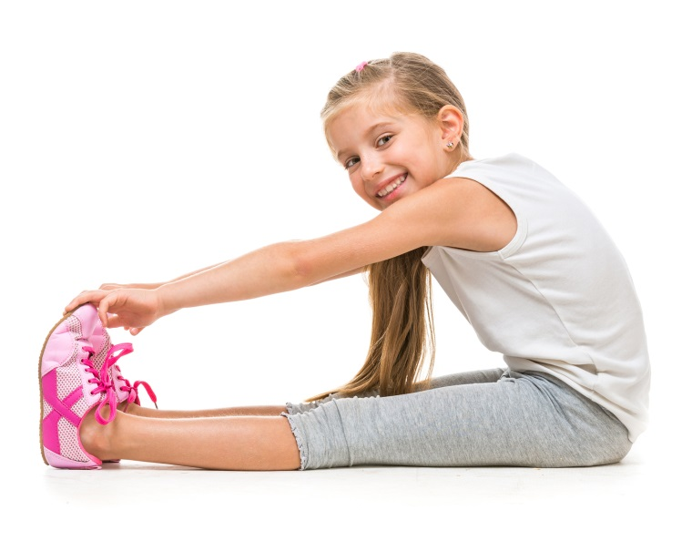

Sensory strategies
Bear Hug
Spaghetti Noodle
Swing/rock
Go for a walk
Wall push ups
Straw (breath or chew)
Blow bubbles
Classical music
Roll on an exercise ball
Trampoline
Visit the Sensory Room
Notes:
Bear Hug = hug yourself suuuuper tight and then let your body fall loose
Spaghetti Noodle = Pretend you’re hard, uncooked pasta (super tense and tight body) and that you’re being cooked (slowly loosen muscles until you flop to the floor like a wet noodle!)
Look at fish tank, or other slow-moving visual in the Sensory Room

Slide 29
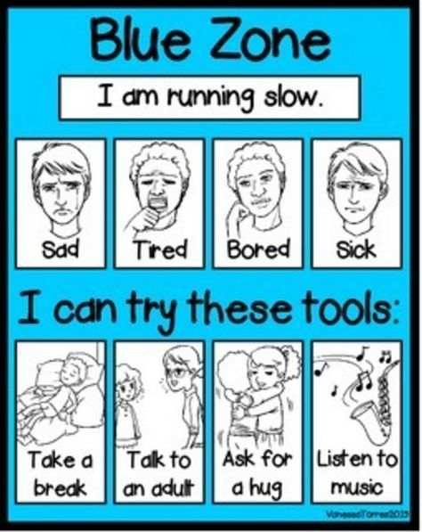
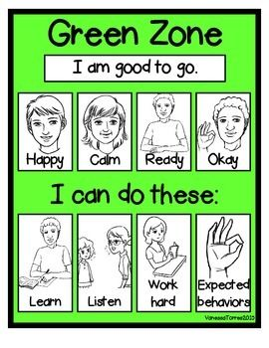
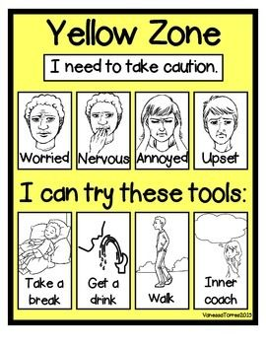
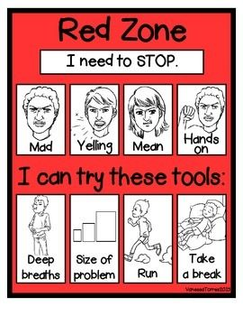
Notes:
Recap – what the zones look like, how they make us feel and the tools that we might use to regulate and get back to green.

Slide 30
Questions

